Slide 1
Frame Processing
Gun Automobile
Edwin Lee, Andrew Maksymowsky, William Kingsford
Notes:
Edwin

Slide 2
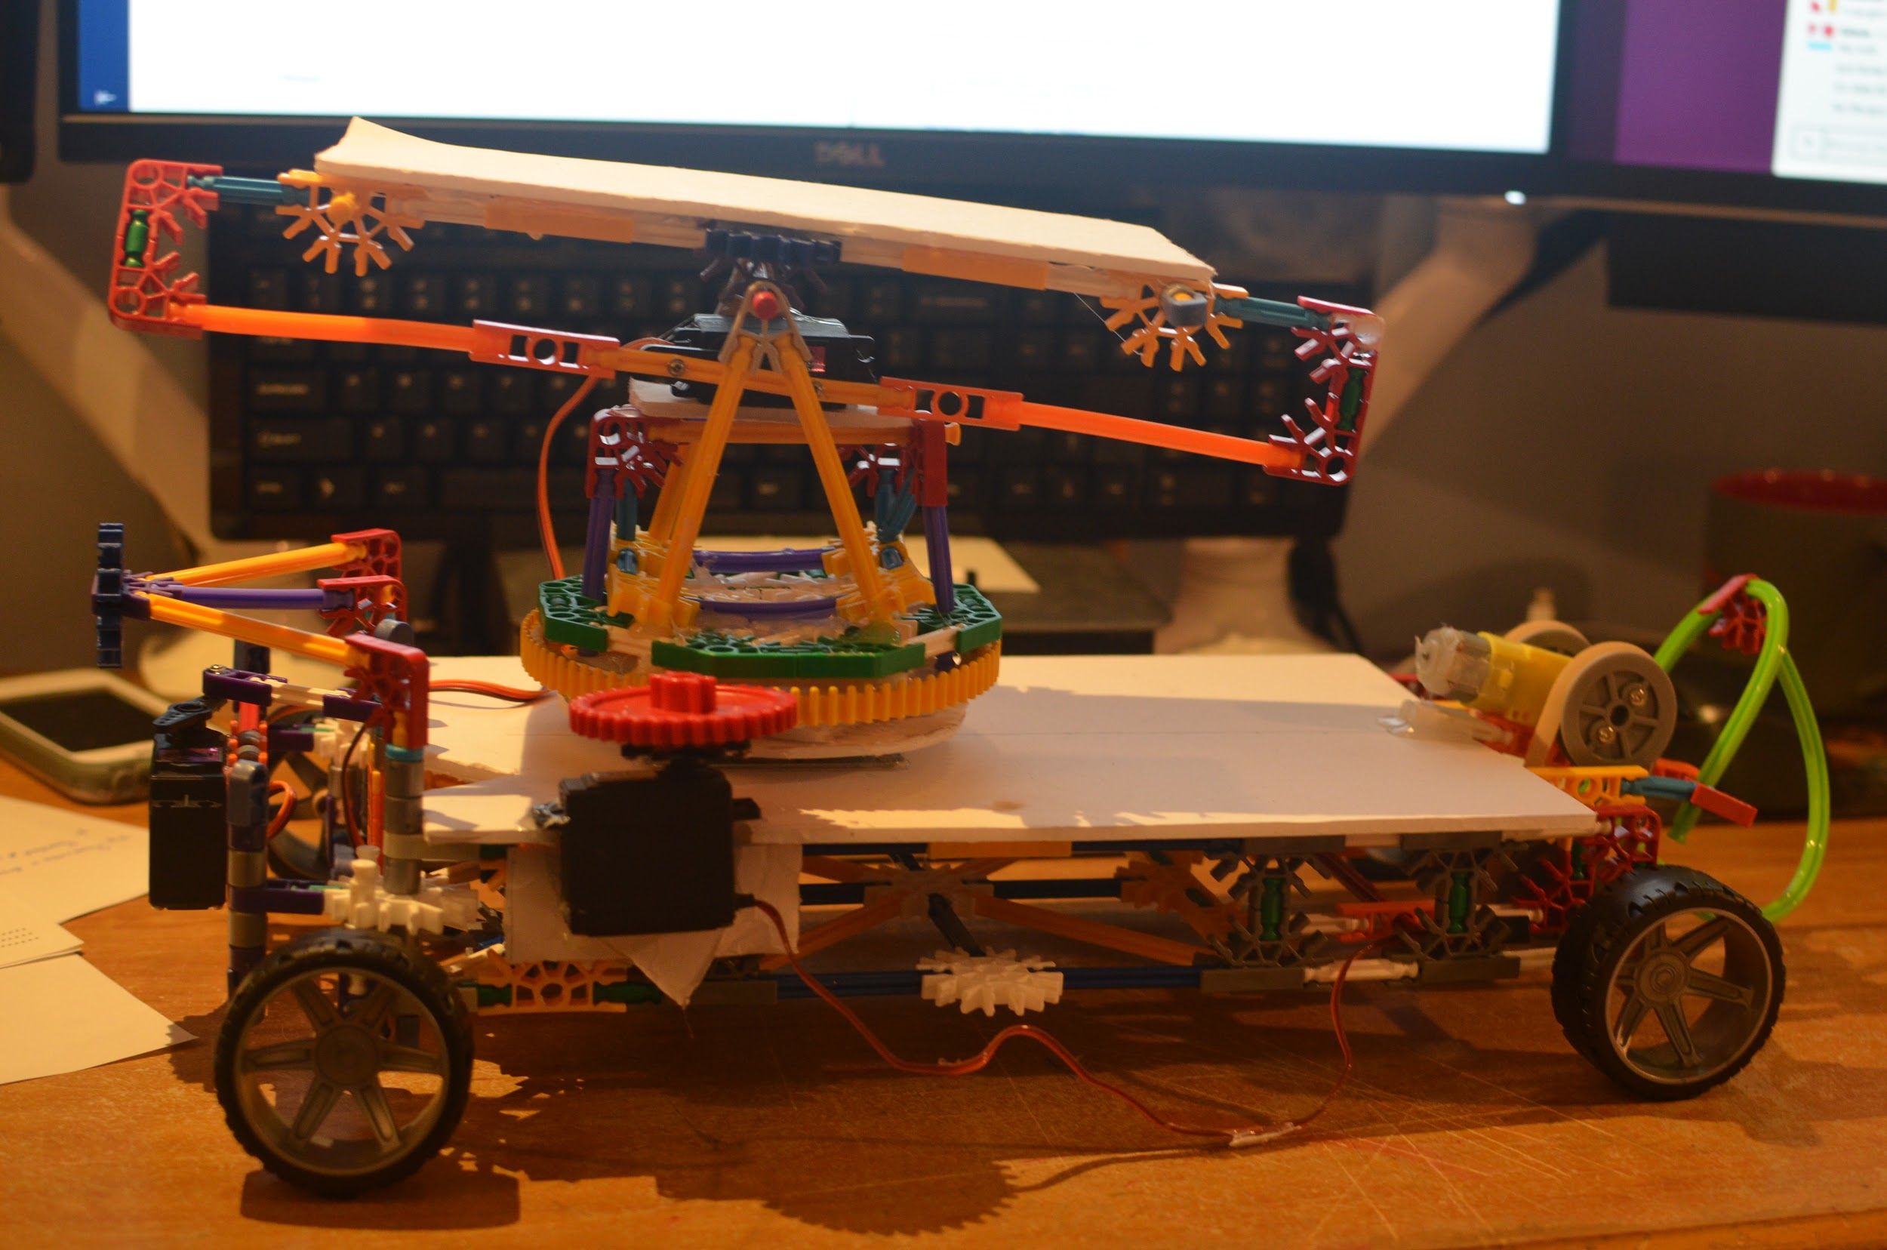
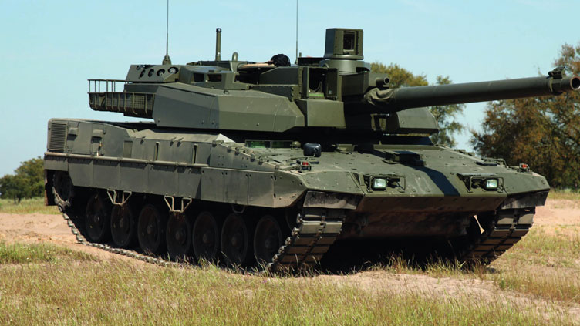
Overview
You
The guy she tells you not to worry about
Notes:
Edwin

Slide 3
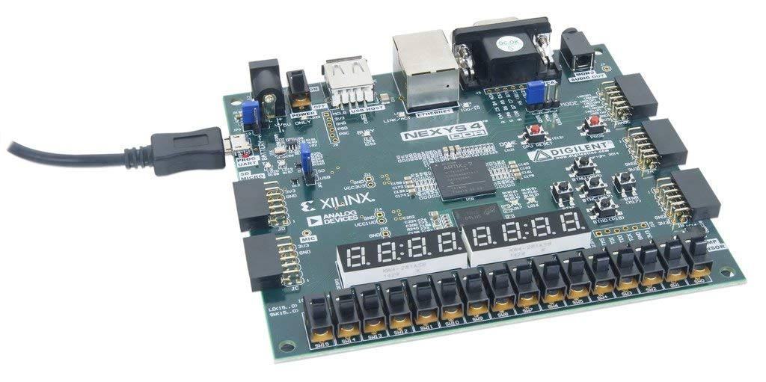

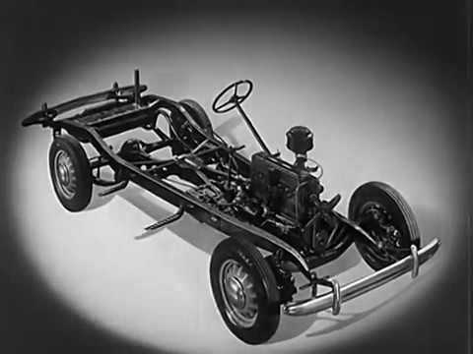



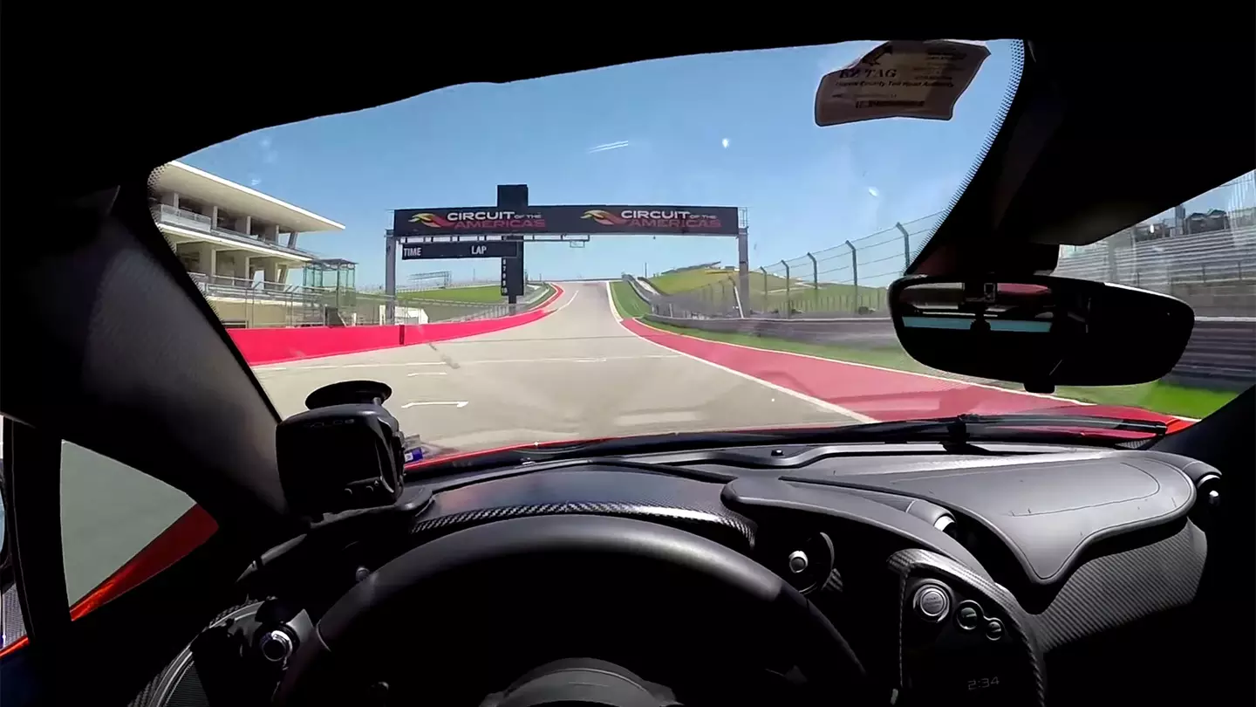

Proposed User Interface
Notes:
Edwin

Slide 4
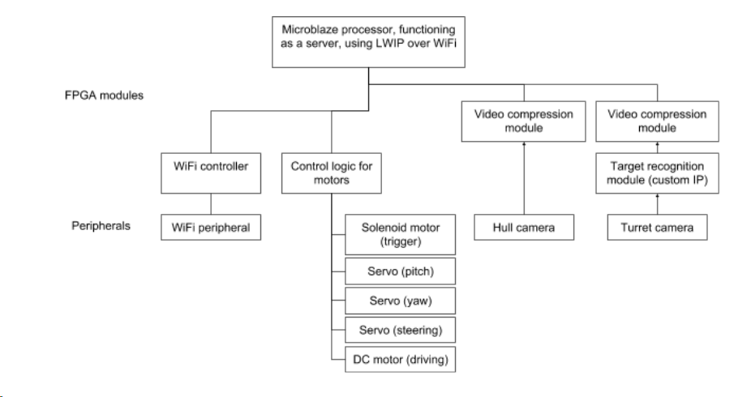
Originally Proposed System - Block Diagram
Notes:
Edwin

Slide 5
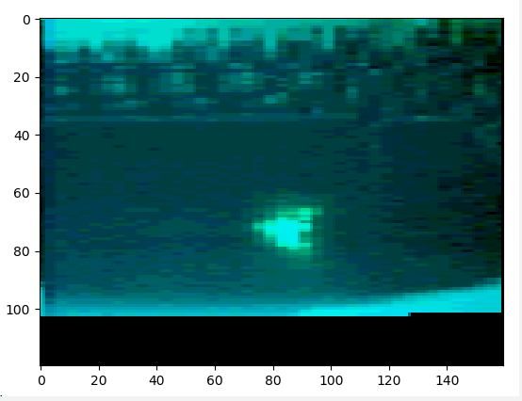
Challenges Shaping our Project
Streaming Interface:
Good Open Source Compression IP (H264, JPEG) doesn’t seem to exist, and Xilinx’s H264 module is only compatible with ultrascale FPGA’s
Noisy wireless networks leading to high latency and packet loss
WiFi throughput issues
IP:
Green filtered camera
Memory realities for IP buffer
Workflow and Mechanical Issues:
Vivado version differences 2017.4 -> 2018.1 -> 2018.3 -> 2017.4
Unavailability of expansion board, physical placement of IP
Notes:
Edwin

Slide 6
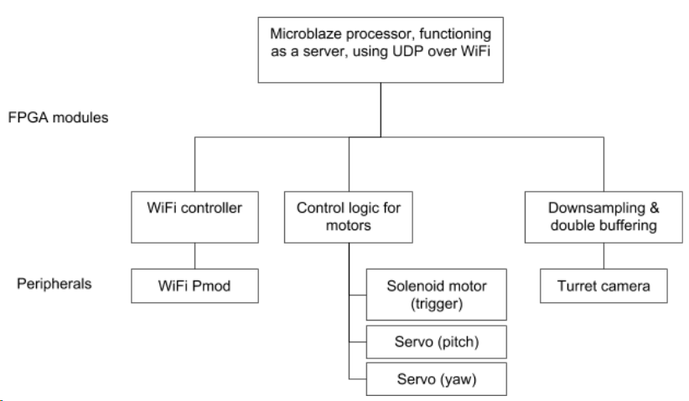
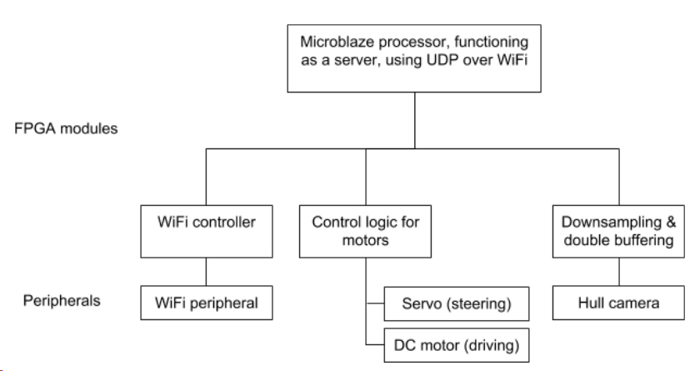
Current System - Block Diagram
Gunner FPGA
Driver FPGA
Notes:
Andrew - Cover what has changed (two boards, no IP on board, UDP instead of LWIP)

Slide 7
Implemented
Leveraged
UDP protocol
C on Microblaze
Desktop client
Display Stream, issue commands
PMOD Camera Driver, Buffer
Image targeting IP
Cross validated Python, C, Verilog
Motor Controller
Digilent WiFi PMOD Driver
Xilinx IP
Microblaze
Memory, Clock generators…
Notes:
Andrew

Slide 8
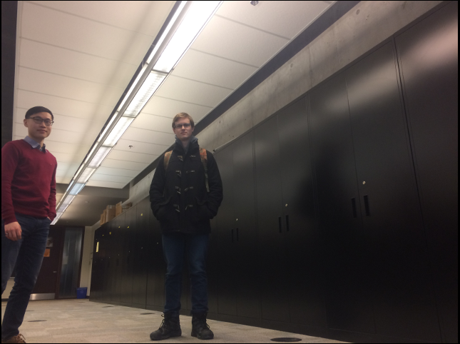
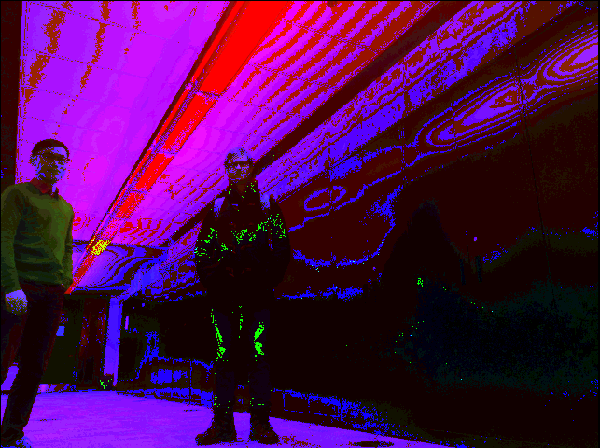

Final Custom IP Flow
Notes:
Andrew

Slide 9


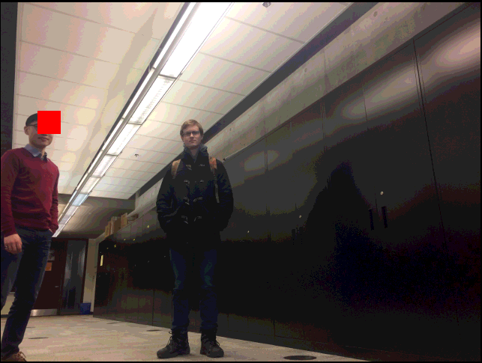
Final Custom IP Flow
Notes:
Andrew - emphasis is on the revised synthesizable Centroid

Slide 10
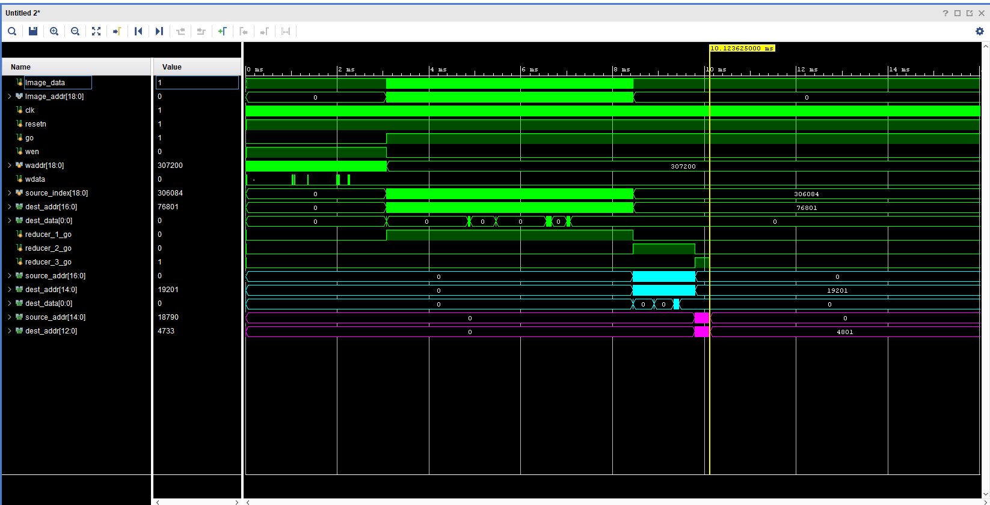
Custom IP Verification Flow
Notes:
Andrew

Slide 11
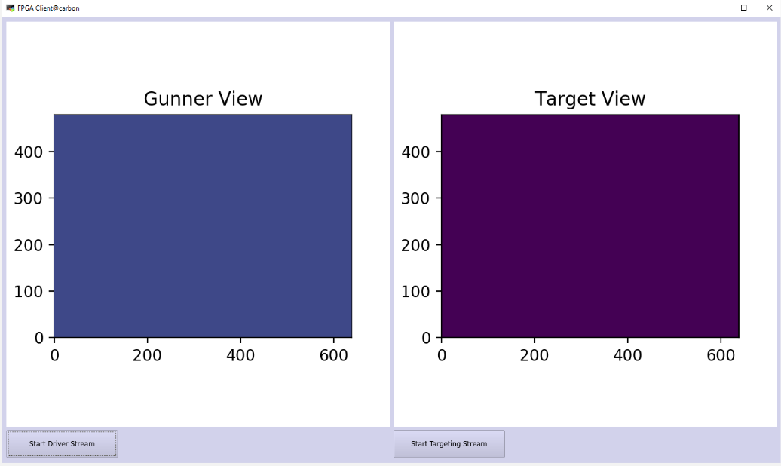
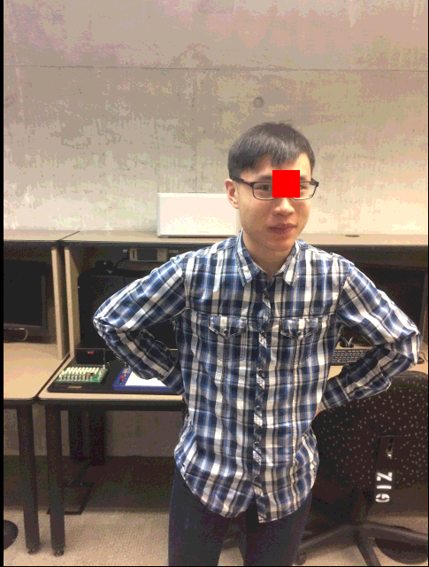
Group Organization
Notes:
Will:
-motivated by Version locks, we split the project into disparate pieces

Slide 12
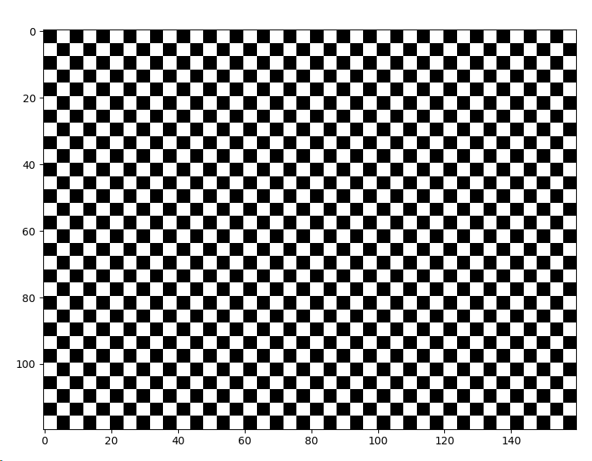
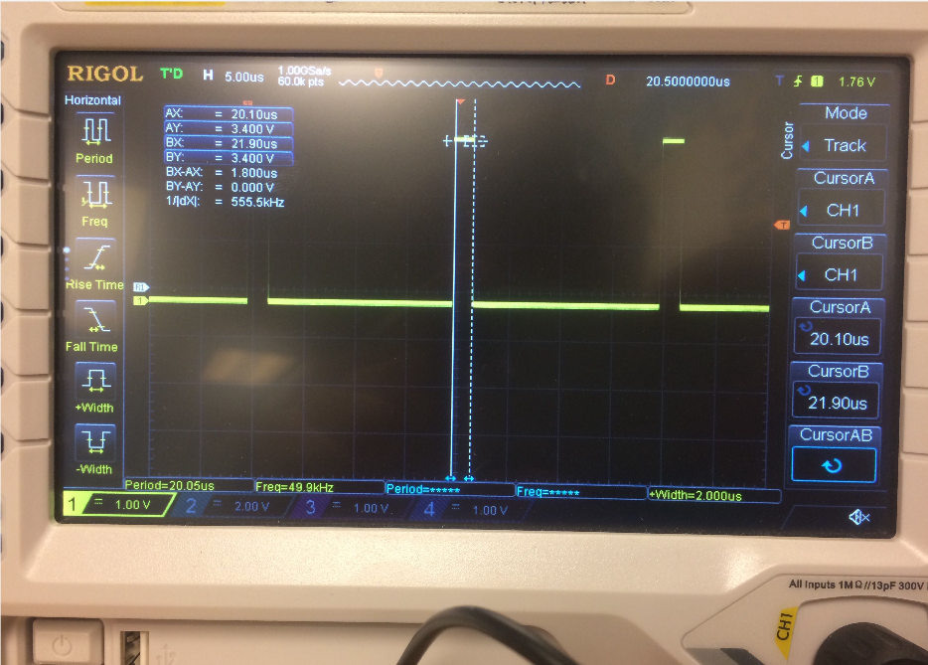
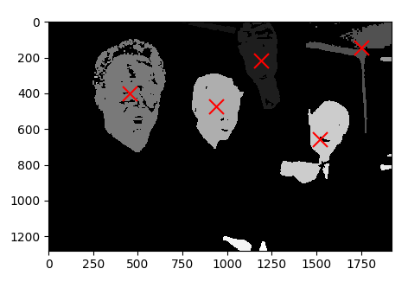
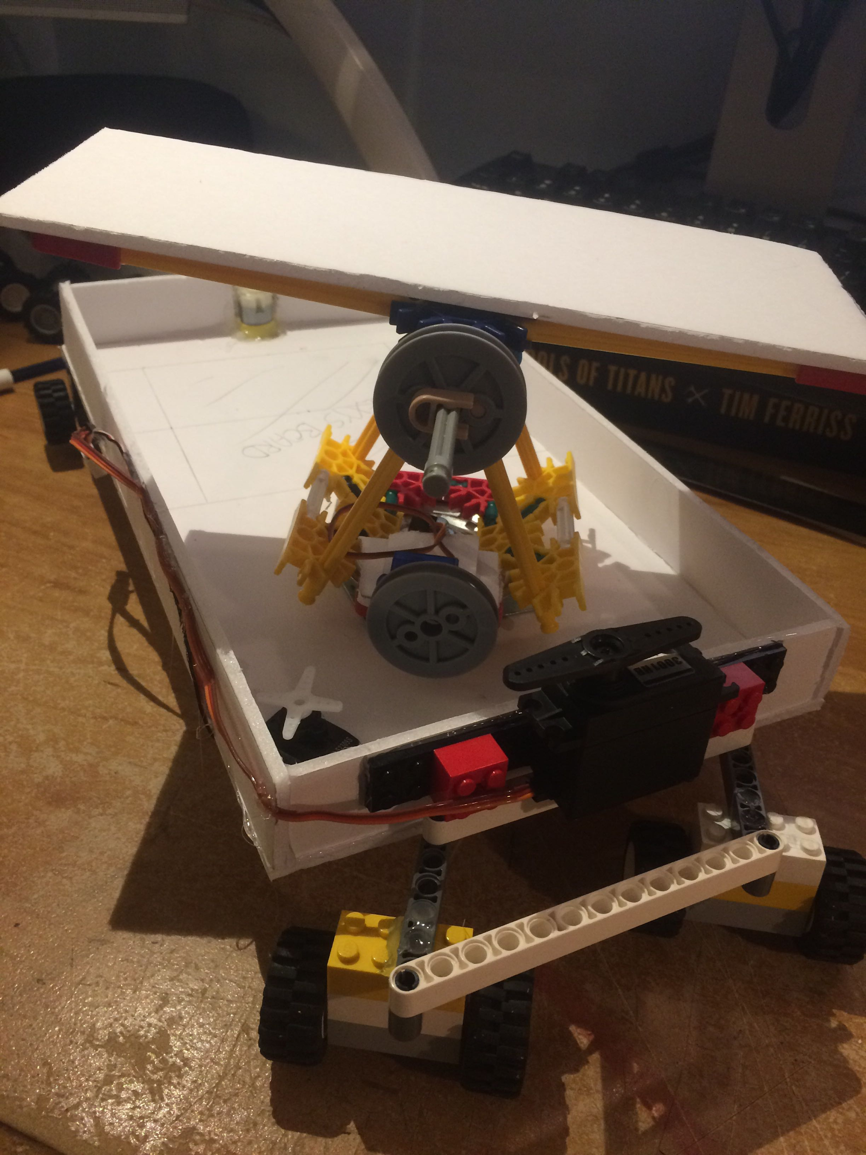
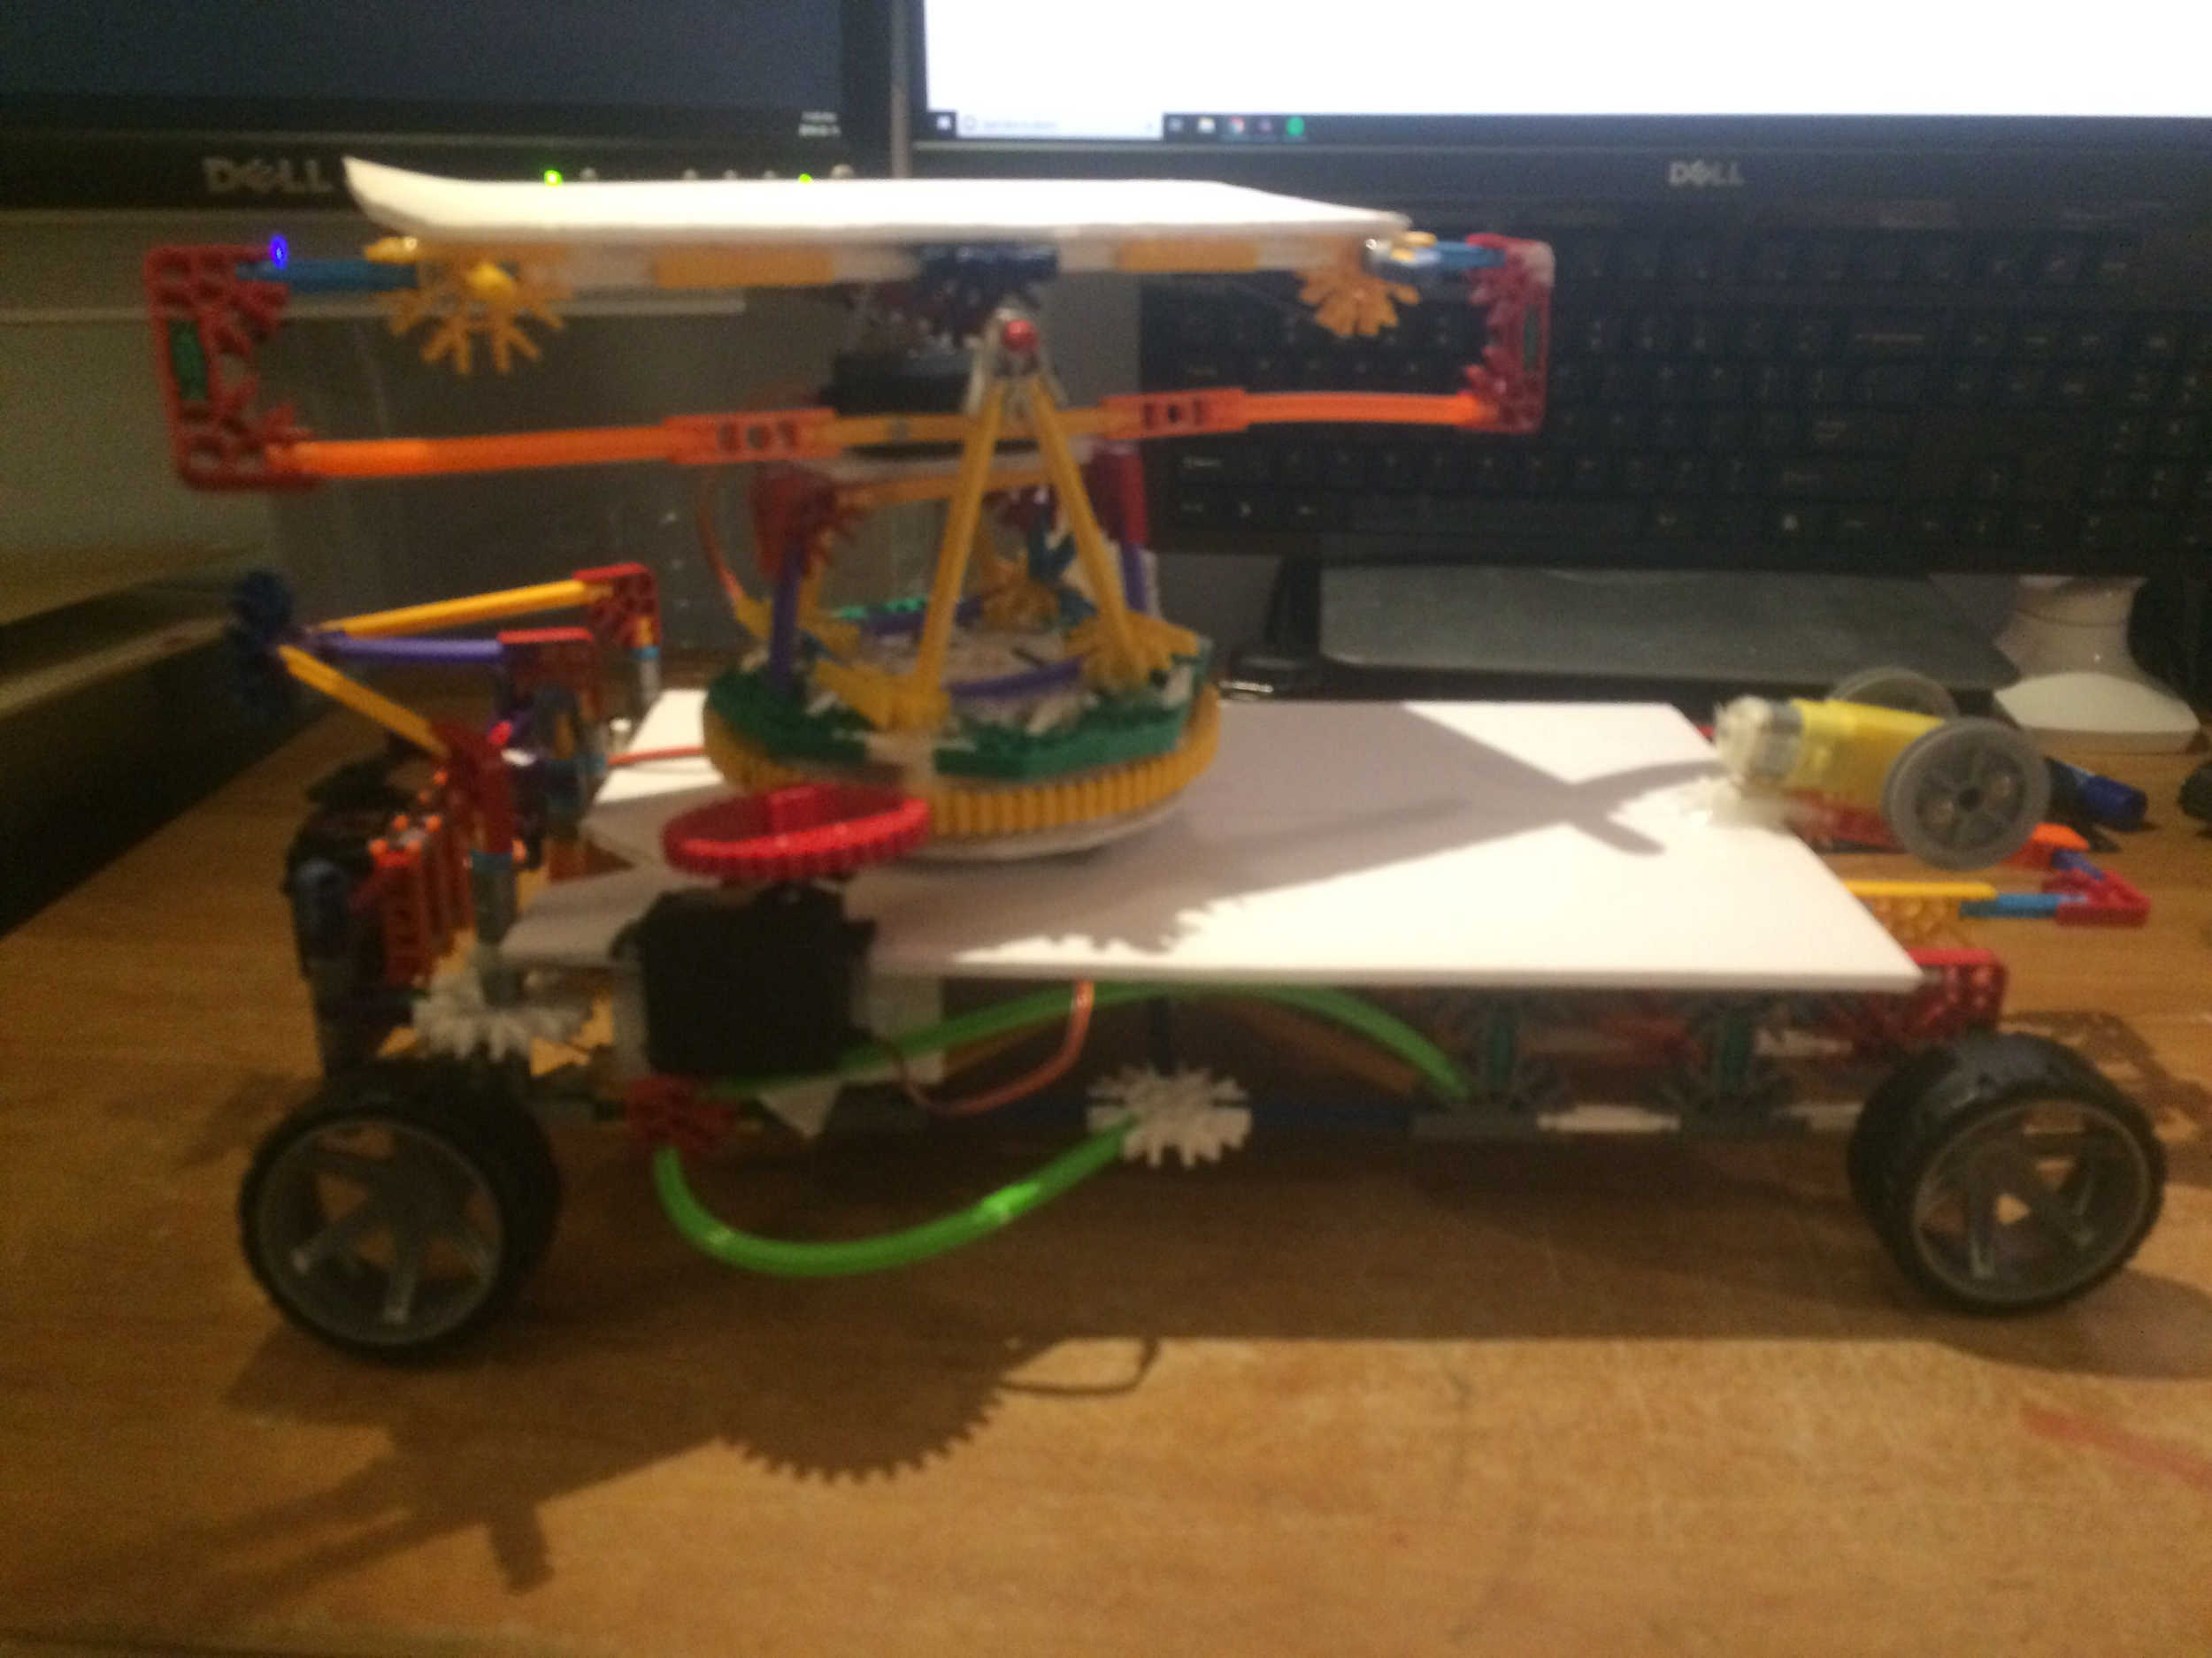


Design Process
Notes:
Will
-Iterative work on all fronts, continual evolution of how they’ll interact
-

Slide 13

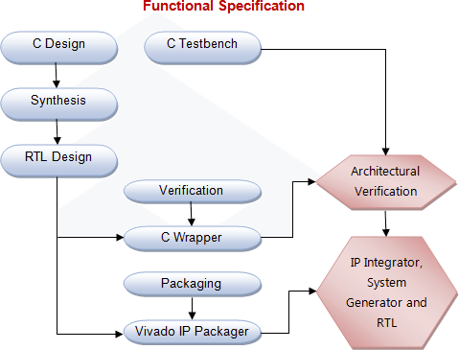

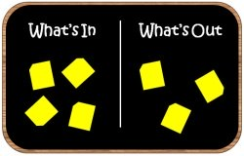
Lessons Learned
Notes:
Will:
-Project scope - our project is 3x failed projects in one
-Lack of experience with tools; random issues can stall prjoect by a week
-Continuous communication as each side evolved critical to our team’s success
-Bigfoot: Each incremental working bit should be archived just in case!

Slide 14
Demo

Slide 15
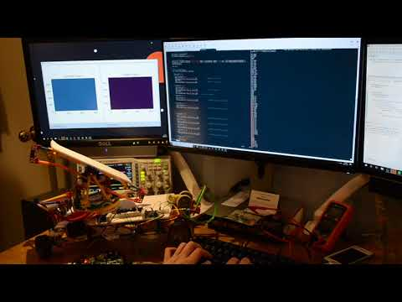
Video Wifi controlled motors
Notes:
Andrew

